Slide 1
Progressive Web Apps & Service Workers

Slide 2
Shout Out To Sponsor

Slide 3
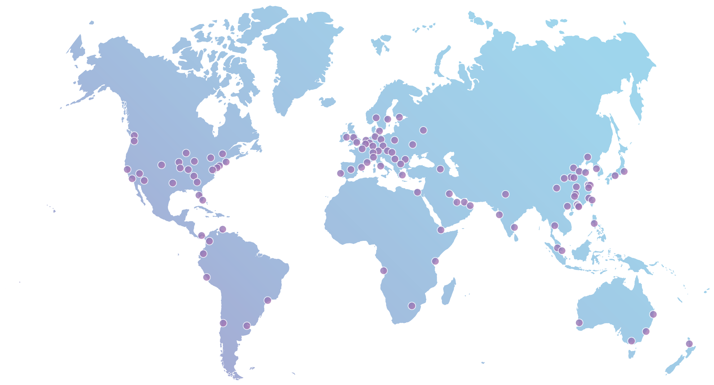
What is Cloudflare?
10MM
Requests/second
10%
Internet requests everyday
135+
Data centers globally
2.5B
6M+
Monthly unique visitors
websites, apps & APIs in 150 countries
Notes:
A quick shout-out to our sponsor today: Cloudflare.
Cloudflare runs 10% of the Internet, providing performance and security to millions of websites. Over 6 million websites, API’s, and apps put Cloudflare in front of their servers to speed up performance, mitigate DDoS attacks, and improve web security.

Slide 4











What is Cloudflare?
Visitors
Visitors
Crawlers & bots
Crawlers & bots
Your website
Your website
Attackers
Attackers
Cloudflare Protected
Notes:
How does Cloudflare work?
Cloudflare sits between your web server (origin server) and the rest of the Internet, serving your content cached from 117+ data centers all over the world. Because of where we sit, we can also inject JS, HTML, and CSS directly into web content, which enables the Cloudflare Apps platform.

Slide 5
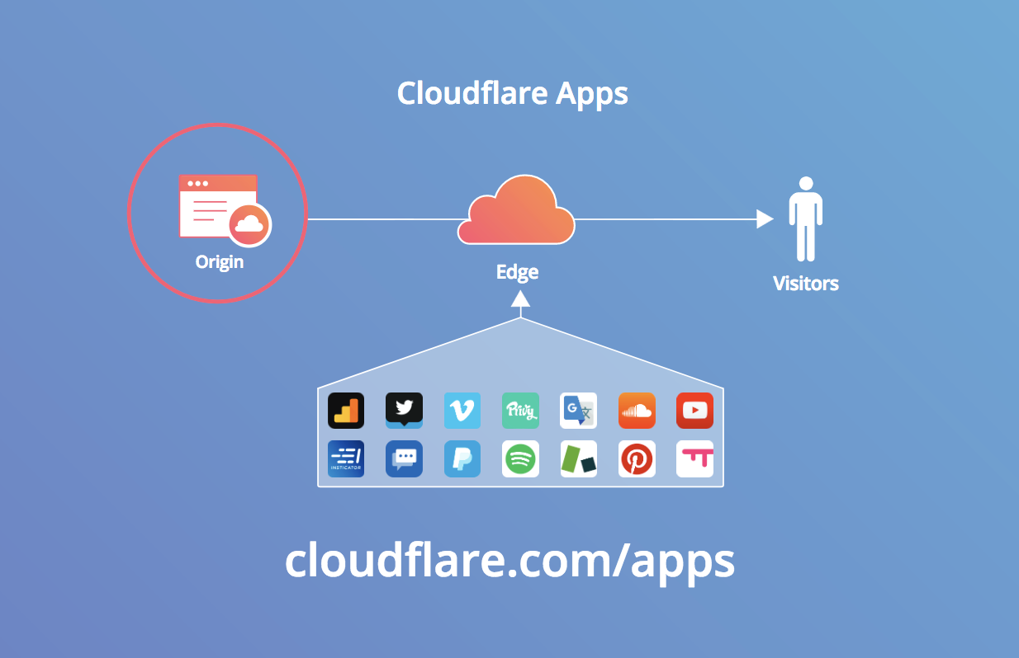
Notes:
As a developer, you can build _apps_ which can be installed by the the millions of sites which rely on Cloudflare. You can even sell your apps; they can make you money _every month_. Visit cloudflare.com/apps to watch how you can build and deploy an app in less than 3 minutes.
Bonus:
App developers can collect up to 100K in Google Cloud Platform credits: https://blog.cloudflare.com/cloudflare-and-google-offer-app-developers-100k/

Slide 6
ANNOUNCEMENTS

Slide 7
Progressive Web Apps

Slide 8
Progressive Web Apps (PWAs) are web applications that are regular web pages or websites, but can appear to the user like traditional applications or native mobile applications
Notes:
Another Definition:
An app that can provide additional features based on the device’s ability to support that feature, providing offline capability, push notifications and almost native app look and speed, and local caching of resources

Slide 9
PWA Features
Progressive
Will work for everyone regardless of browser or device, even an older one with less features
You will hear this a lot: "They’re built with progressive enhancement as a core tenet."
Feel Like Native Apps
It doesn’t feel like a website, but rather as an app as much as possible with app-like interactions
Offers Offline Support
Uses Service Workers to cache data and page information into the device’s storage
Notes:
Older Devices:
Run as a website and not installed
Progressive Enhancement:
Progressive enhancement is a strategy for web design that emphasizes core webpage content first. This strategy then progressively adds more layers of presentation and features on top of the content as the end-user's browser/internet connection allow.
The proposed benefits of this strategy are that it allows everyone to access the basic content and functionality of a web page, using any browser or Internet connection, while also providing an enhanced version of the page to those with more advanced browser software or greater bandwidth.

Slide 10
PWA Features
Secure
Uses Service Workers to Fetch data which can only be done through HTTPS
Responsive
UI will adapt any screen size (desktop, laptop, mobile, tablet….next)
Add To Home Screen
The browser prompts the user to add to home screen (aka Install The App)
Push Notifications
Utilizing push notifications allows a user to stay engaged even if the browser is closed

Slide 11
PWA Features
Easy To Update
Can push changes whenever you want and the app will refresh itself
Easy To Find
Identified as an application which allows search engines to find it and help bring more users
Distributable URL
Can point to or pass around the application URL
Notes:
Update:
This happens through the Service Worker and typically it takes you coming back to a site twice before those changes are updated

Slide 12
Other Benefits
Lightweight
Typical apps are in the MBs where as a PWA is usually in KBs
Cost of Acquisition
Easier to get a user to visit a website than have them download an app (if they have room) and then open it
Development Effort
Single code base
Notes:
Summary:
These are benefits that are not typically seen to the end user
Development Effort:
Only need to know the code base for your web application probably as a SPA. Don’t need to know Swift/ObjectiveC or Java.
Event most hybrids aren’t single code base. Ionic might advertise it…Ionic developer told me not the best idea. React has ReactNative

Slide 13
Service Workers

Slide 14
A Service Worker is a JavaScript file that acts as a middleman between the web app and the network
Notes:
Summary
Like a web worker

Slide 15
Worker Context
Runs in the background
Non-blocking
Can work when mobile application/browser is closed
No Access
DOM
XHR API
Local Storage API
Access Granted
Promises
Fetch API
Cache API
Notes:
Summary
Worker Context is a different thread than the UI thread
Run in Background
When mobile application is in the background or closed
When the browser is closed…assuming the application/service worker is installed

Slide 16
HTTPS
Can only be used on the HTTPS Protocol
For development purposes, we can use local calls

Slide 17
Lifecycle
Registration
Specifies the path of the service worker to the browser
Starts the install in the background
Initialization
Called when not installed or has been updated
Good time to pre-fetch some of your base files
Activation
Cleanup anything with the old version
Useful with new page loads, not already loaded pages
Notes:
Activation
Cannot interact with pages already loaded
Only useful the 2nd time the user interacts with the app or if the user reloads the page

Slide 18
Lifecycle
Registration
Installation
Activation
Notes:
Activation
Cannot interact with pages already loaded
Only useful the 2nd time the user interacts with the app or if the user reloads the page
Code
Let’s look at some code….need to show project that only has these three pieces of the lifecycle. No Angular
NEED TO LIST PROJECT NAME HERE

Slide 19
Consistency
Service Worker will want to be the same across all open tabs
Will install but not update
All tabs will need to be closed and if only one is open, it will have to reload….
Notes:
Discussion
Talk of console for initial load
Talk of console for 2nd load
Talk of console and application after update
Talk of console and application tab for new after update

Slide 20
Registration Scope
Additional parameter in navigation.serviceWorker.register
Determines what part of application service worker controls
Defaults to subfolders and files under it’s current location
Cannot go up its relative path
Single Instance
Independent of application associated with, so a single instance per domain and scope
Notes:
Scope Parameter
Understand difference between /widgets/ and /widget
Single Instance
Show console logging and how it shows on two tabs
Show console logging and how it appears with different domains

Slide 21
Single Domain
Tab 1
Tab 2
Service Worker

Slide 22
Multiple Domains
Tab 1
127.0.0.1
Tab 2
172.10.1.1
Service Worker 1
Service Worker 2

Slide 23
Multiple Scopes
Tab 1
127.0.0.1/Products
Tab 2
127.0.0.1/Admin
Service Worker 1
Service Worker 2

Slide 24
Caching
Main ingredient for offline support
Precache during initialization
Network requests
Notes:
Offline Support
Items that are cached, will be returned online or offline
PreCache
Assets reused throughout the application...images, css, JS
Necessary files to display App Shell (will cover later)
While application is loading user will not see a blank screen
Network Requests
Listen for the Fetch API request.
If request (url) is found in cache then return that value, otherwise make the call and return the result
Every request must be called at least once so that the cache can be used
CODE
Show caching and using the Fetch API

Slide 25
Updating Service Worker
Update any byte and rebuild. All that we talked about with consistency will take care of the rest

Slide 26
Chrome Dev Tools
View the Service Worker
View the Service Worker waiting to be updated
View the Cache
View the Manifest
Check the add to home screen functionality

Slide 27
App Manifest

Slide 28
App Manifest
manifest.json
Simple JSON file
Gives developer ability to control how your app appears to the user
Provides your web app
Ability to launch in full screen mode
Rich presence on home screen
Screen orientation
“Splash screen” and theme color
Track how you launch (home screen or url)
Notes:
Tracking Launch
Add a query string to the start_url parameter
Use an analytics suite to track the query string
Remember to update files cached by the App Shell so that file with the query string is cached.

Slide 29
App Manifest
Add to head tag
<link rel="manifest" href="/manifest.json">
Criteria used by browser
Use of service worker
Valid manifest file
SSL Status
Visit frequency heuristics
Manually add
Use Add to Home Screen button in Dev Tools
Notes:
Cool little app
https://github.com/cubiq/add-to-homescreen
Manifest Validation Tool
https://manifest-validator.appspot.com/

Slide 30
App Manifest
Manifest Validation Tool
Lighthouse
https://manifest-validator.appspot.com/
Manually add overlay
https://github.com/cubiq/add-to-homescreen

Slide 31
Push Notifications

Slide 32
Push & Notifications
Two separate JavaScript APIs
Push API
Allows messages to be sent to applications from a server
Notification API
Displays native system notifications
Notes:
Push API
Lets developers deliver asynchronous notifications and updates to users that opt in

Slide 33
Data Flow
Browser Push Service
App Client
App Server

Slide 34
Browser Push Service
Implemented by browser company
Push notifications to user browser
Identifies user anonymously when the user subscribes
Messages are encrypted so it is just a pass through
Notes:
Nice To Know
Browser companies first priority is to guarantee a satisfactory user experience
Due to the above, the browser push service will block messages if notifications are too often
Transition
How to identify that the user is subscribing to our application

Slide 35
VAPID
Creates a public and private key
Ways to get VAPID Keys
https://web-push-codelab.glitch.me/
web-push npm module
NuGet WebPush-NetCore
Notes:
Transition From
How to identify that the user is subscribing to our application

Slide 36
App Client
getSubscriptions
Check if the subscription already exists
Subscribe: Ask user if allowed or blocked
userVisibilityOnly
applicationServerKey
Listen for “push” events
Using the payload passed in make a call through the Notification API
serviceWorker.registration.showNotification
Call application server to store subscription object
Notes:
Subscribing
userVisibilityOnly -> Required by Chrome. Agreement that you will not user silent pushes
applicationServerKey -> This is the VAPID public key as a Uint8Array

Slide 37
App Server
Setup Web Push Client
Uses both public and private keys
Send Push Notification Payload
User the Web Push Client to send the payload
Payload Object Properties
Text
Image
Vibrate Pattern
Body

Slide 38
Angular Implementation

Slide 39
Angular Abstraction
How to get Angular as a PSA
ng add @angular/pwa
Files Added
Also adds @angular/service-worker
Lots of assets/icons
ngsw-config.json
manifest.json
Notes:
Transition
Progressive Web Apps and Service Worker functionality is all generic. Angular does a good job of abstracting a lot of that using the CLI
CLI Production Build
Service Worker is generated, but will abstract the registration, installation, and activation.
The ngsw-worker.json will help determine our pre-fetch and lazy loaded cache files

Slide 40
Angular Abstraction
Files Modified
angular.json
app.module
index.html

Slide 41
@angular/service-worker
SwUpdate
Helps manage version updates
Install new service worker when it is ready rather than upon reload
SwPush
Abstracts the subscription to the browser push service
Notes:
SwUpdate
Available -> Observable that when notifies will install the new service worker.
Makes it so that we don’t have to open once to install and then another to get the new version

Slide 42
Device Support

Slide 43
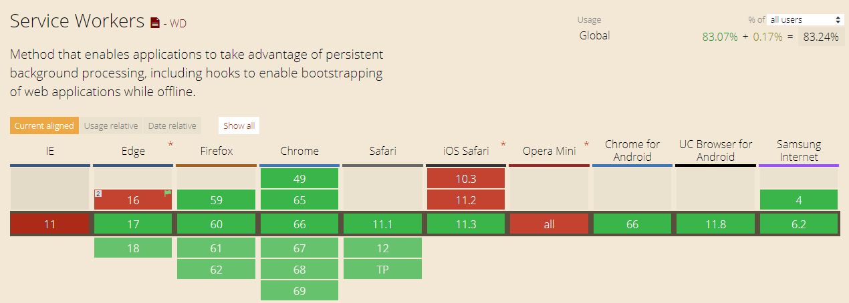
Service Workers

Slide 44
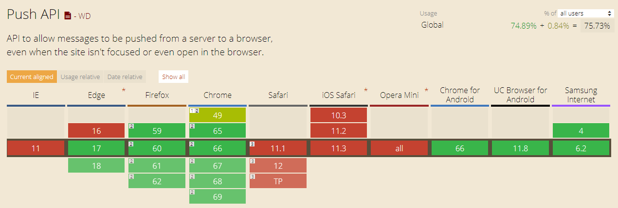
Push API

Slide 45
iOS Issues
Background synchronization
Push notifications
Some APIs like TouchID, ARKit, In App Payments, Split View on iPad
Orientation lock
Statusbar color change
Proper app screen in task manager (which would show current app screen, not splash image)

